Slide 1
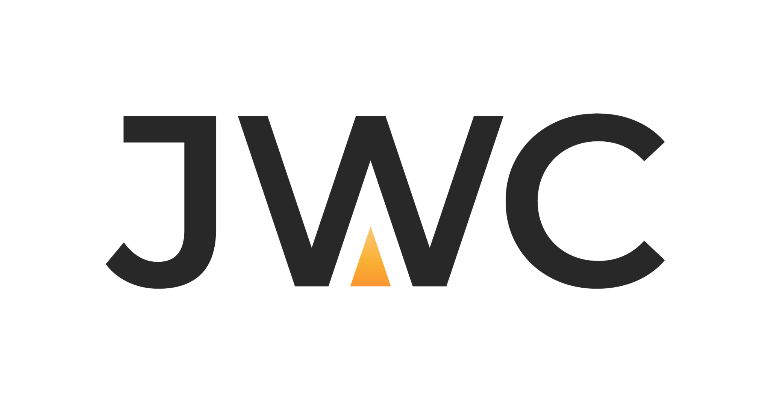
COMPANY PROFILE
Joint Words Communication (JWC)
JANUARY 21,2025

Slide 2


JWC is a strategic communications and public relations consultancy.
With a proven track record of over 15 years across Saudi Arabia and the wider region, our diverse team blends international expertise with deep local market understanding, allowing us to deliver high-impact solutions tailored to the unique needs of each client.
At JWC, we specialize in strategic communications advisory, stakeholder engagement, internal and external communications, and full-spectrum PR services. From strategic planning and reputation management to media crisis management, we craft innovative, integrated solutions that help organizations communicate with clarity, confidence, and impact.

Slide 3
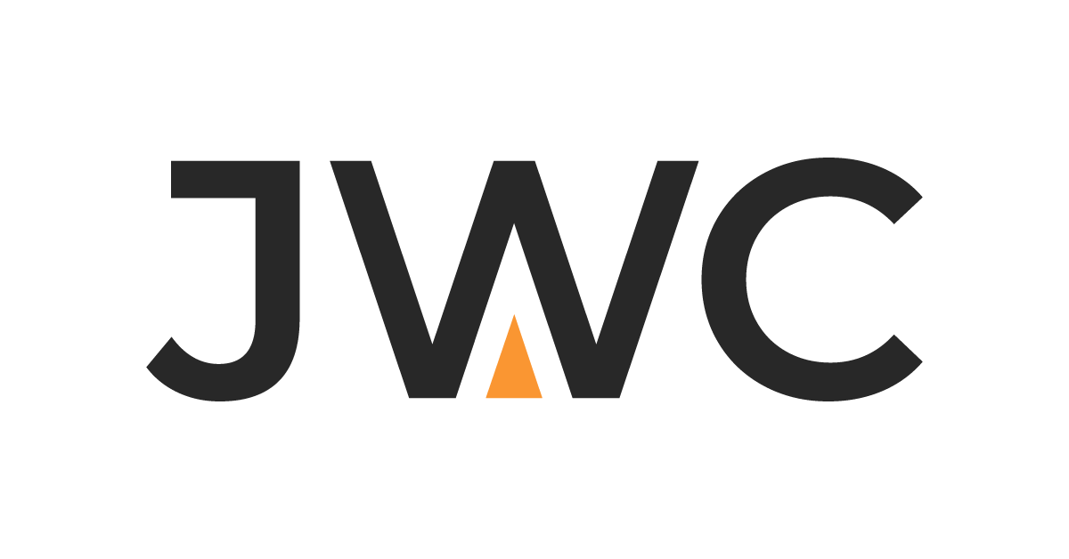
We design communication strategies that shape public perception and influence behavior empowering decision makers to better address the needs of their stakeholders.

Slide 4



Why does JWC stand out?
Proven Impact
Our work is driven by results—we measure and optimize communication strategies for maximum effectiveness.
Extensive Expertise
Our team brings a wealth of experience in strategic communication, public relations, and marketing consultancy
Bespoke Solutions
Every client is different so we create solutions that fit their exact needs.
4

Slide 5




Core Services
We believe effective communication is the cornerstone of any organization’s success. That’s why we offer unique consultancy in communication and public relations, helping to build a strong reputation and strengthen our clients' brand in competitive markets.
Reputation Management
Media appearances
Public Relations
& Media Crisis Management
Communication & Marketing Strategies
Strategic Communication
& Positive Collaboration
5

Slide 6



Strategic Communication & Positive Collaboration
Strategic Communication and Positive Collaboration are fundamental in enhancing effective relationships between diverse stakeholders.
We believe that collaborative work is the key to building deeper understanding and reducing communication gaps between leaders in the private sector and decision-makers in the government sector.
Strategic Communication Frameworks
Communication and
Engagement
Image Building
Advocacy
This framework seeks to facilitate communication and engagement with our clients by meeting the needs of their target groups. We implement our methodology through various platforms, including: Digital Marketing, Events and Conferences, Public Relations, Initiative Activation.
This framework aims to influence stakeholder perceptions by authentically expressing the client's vision and values through reliable strategies that ensure consistency across all communication channels.
We work with clients to identify target perceptions and apply our methodology to achieve desired outcomes.
We collaborate with the private sector to align their voices through clear communication management that effectively and concisely addresses their challenges.
Implementing this framework involves assessing and analyzing the current situation, understanding organizational structures and governance, and providing initiative design services, administrative and executive support, and project management office services.
6

Slide 7







Communication and Marketing Strategies
We develop comprehensive communication and marketing strategies, including internal and external communication, media visibility, public relations, and reputation management for various entities. We have participated in building over 100 diverse communication plans and strategies.
Internal Communication Strategies
Reputation Management Strategies
Public Relations Strategies
Marketing Strategies
Specialized Campaign and Media Center Strategies
Media Crisis Strategies
Specialized Strategies for Media Centers
7

Slide 8








Communication and Marketing Strategies
At JWC, we represent the public relations and media management role for organizations as well las manage media centers for events and activations, focusing on providing comprehensive administrative and communication needs aimed at building and maintaining a positive institutional image and effective public engagement.
Media Relationship Building
Media Campaigns
Corporate Communication Management
Internal Communication
Media Center Management and Operation
Content Management
Reputation Management
Crisis Management
8

Slide 9








Reputation and Media Presence Management
We manage individual and organizational reputation and presence through specialized services designed to build a positive, trustworthy image and enhance visibility across traditional and digital media platforms.
Reputation Analysis and Evaluation
Personal or Corporate Branding
Reputation Management Strategies
Online Reputation Management
Media Presence Management
Media Crisis Management
Media Monitoring and Analysis
Digital Reputation Management
9

Slide 10
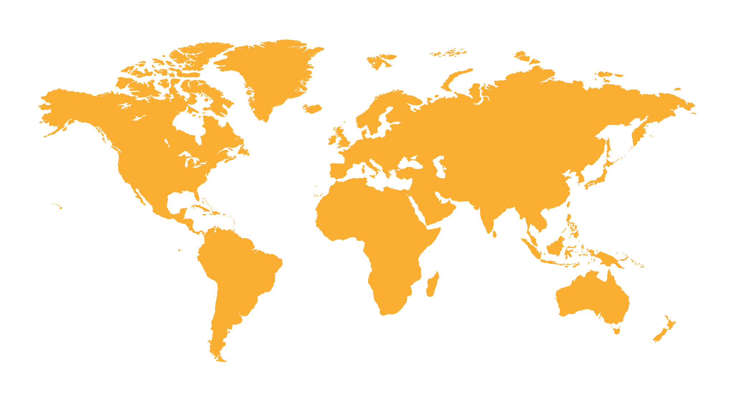
International Presence
Kingdom of Saudi Arabia | India | Egypt | Bahrain | United Kingdom | Italy | United Arab Emirates | Turkey
Our presence spans multiple regions and countries around the world, providing communication consulting services and executing public relations and communication campaigns,
which has helped us appear on various media and digital platforms
10

Slide 11
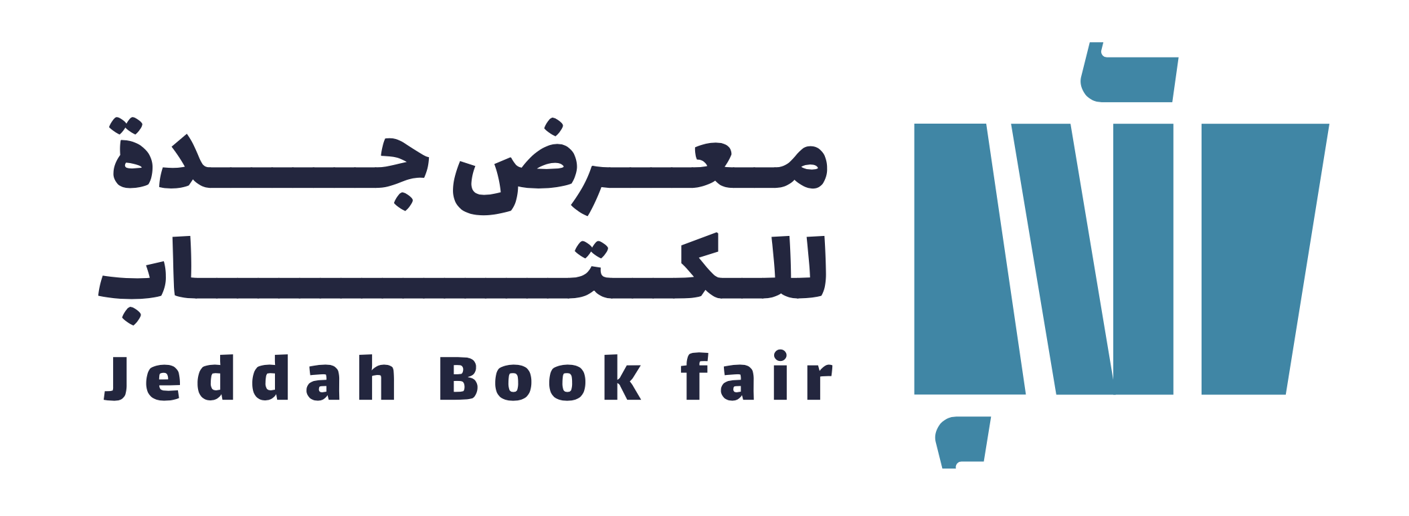

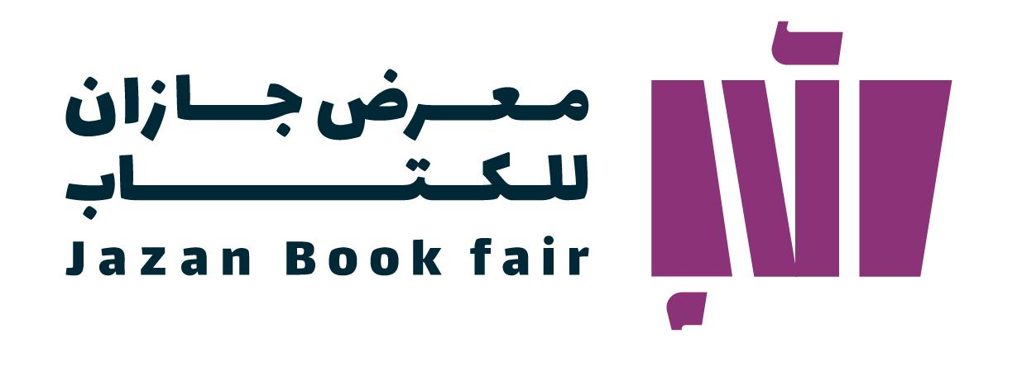


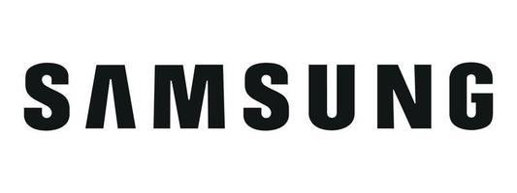






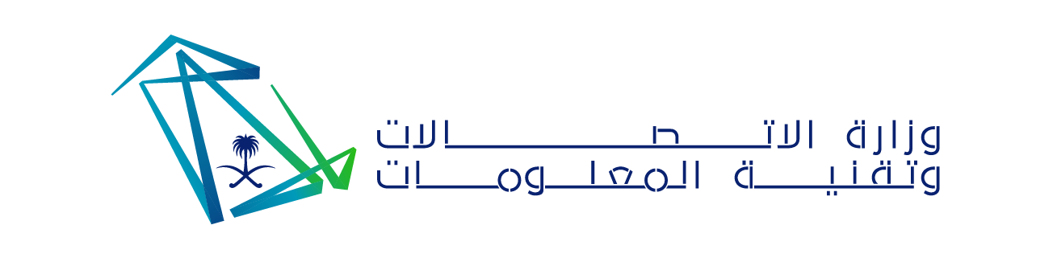





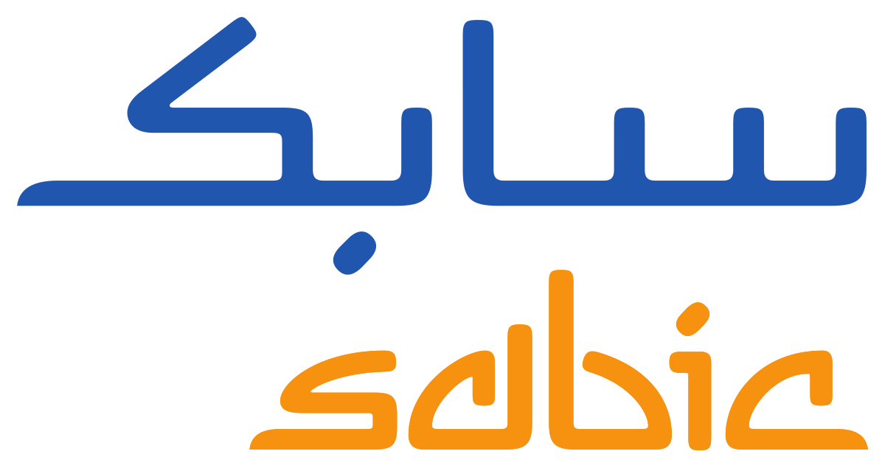










Our Prominent Clients
11

Slide 12
www. jwc.sa
info@jwc.sa
Prince Turki Bin Abdulaziz Al Awal Rd, Al Mathar Ash Shamali, Riyadh 12314
+966 506 123 777

